Slide 1
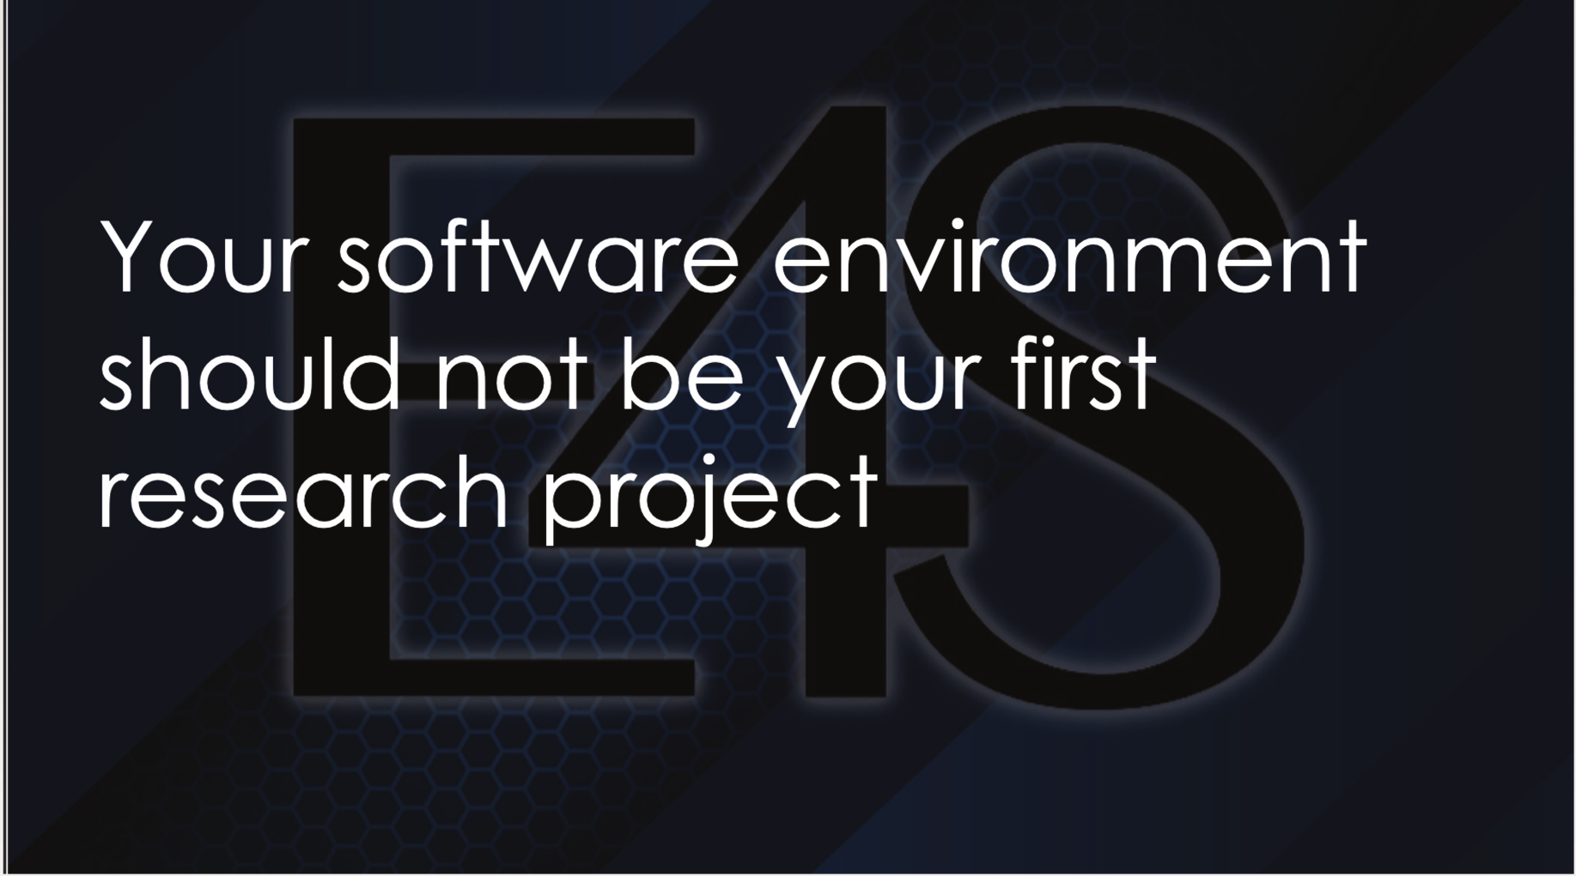

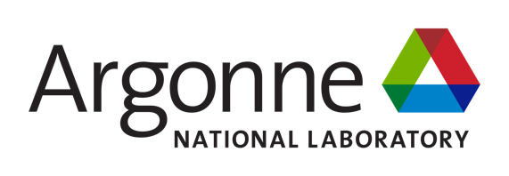










E4S: No One Should Debug a Software Stack Alone
Scientific Achievement
E4S, the Ecosystem for Science, gives new researchers a curated, tested environment instead of one built from scratch
Spack-based deployment, prebuilt containers, and facility-ready installs replace days-to-weeks of setup
100+ libraries and tools, tested across NVIDIA, AMD, and Intel CPUs/GPUs
E4S also provides a growing set of vendor-specific libraries and tools for advanced AI-for-science workflows
Result: a new group member productive on day one, not week three
Significance and Impact
Removes the setup burden that otherwise falls on a mentor walking a newcomer through the stack by hand
Frees mentor time for the science, not software troubleshooting
Turns onboarding from a solo struggle into a known quantity
A research software environment should be a starting point provided by E4S, not the first project a newcomer has to solve alone. In addition to easy access to the E4S collection of libraries, tools, and apps, users can access the E4S website (https://e4s.io) for quickstart recipes, a searchable and sortable product catalog, and an AI guidebot to answer user questions.
Technical Approach
Spack captures versions, variants, compilers, dependencies for reproducible configuration
Prebuilt containers and facility installs give newcomers a tested baseline, not a blank system
CI on DOE leadership-class platforms on Frank@UO catches portability issues early
PIs: Michael Heroux, (ParaTools, Inc.), Lois Curfman McInnes (Argonne)
E4S lead: Sameer Shende (U of Oregon/ParaTools)
ASCR Program: Next-Generation Scientific Software Technologies
ASCR PM: David Rabson
E4S website: https://e4s.io
PESO website: https://pesoproject.org
https://pesoproject.org
Stewarding and advancing the current and future ecosystem of HPC-AI computing software
Notes:
LOCAL LAB POC:
Sameer Shende, University of Oregon, Argonne National Laboratory
TALKING POINTS:
New researchers, and the mentors who supervise them, routinely lose their first days or weeks on a project to software setup rather than science. Configuring compilers, libraries, programming models, and dependencies so they work together on a given system is its own specialized skill, one that has nothing to do with the research question at hand.
E4S, the Ecosystem for Science, exists to remove that barrier. It is a curated, tested, and interoperable collection of more than 100 open-source scientific libraries, tools, and applications, deployed through Spack, prebuilt containers, and facility-ready installations, with broad support for NVIDIA, AMD, and Intel CPU and GPU architectures.
In addition to easy access to the E4S collection of libraries, tools, and apps, users can access the E4S website (https://e4s.io) for quickstart recipes, a searchable and sortable product catalog, and an AI guidebot to answer user questions.
The practical effect is on onboarding. A new student or postdoc, and the mentor who would otherwise walk them through the stack by hand, can instead start from a working, validated environment. Time that used to go to troubleshooting goes to the research itself.
This also benefits reproducibility and portability: the same curated environment that gets a newcomer running on a laptop is deployed and tested on DOE leadership-class systems, so a project's software environment does not have to be rebuilt as people move between machines or as new team members join.
PESO's investment in E4S is DOE turning software infrastructure into faster, more reliable onboarding for the next generation of computational scientists.
METADATA:
Name of the associated awarded project: PESO, Consortium for the Advancement of Scientific Software (CASS)
PI names: Michael Heroux (ParaTools, Inc.), Lois Curfman McInnes (Argonne National Laboratory)
E4S lead: Sameer Shende (University of Oregon / Argonne National Laboratory.)
Name of the program manager: David Rabson, ASCR Next-Generation Scientific Software Technologies
Software references: E4S, https://e4s.io ; Spack, https://spack.io .
E4S publishes curated, versioned releases of the full software stack, so a container tag plus a Spack specification is sufficient to reconstruct the exact software environment used by a project or a new team member.

